Slide 1
Intro to Openvas
CW3 JAMES HONEYCUTT

Slide 2
About_Honeycutt
24 Years of service (21 in IT/Cyber)
Former PEC SysAdmin
Now team expert for Windows and PowerShell
PowerShell enthusiast

Slide 3
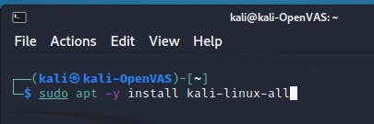
OpenVAS Install
Notes:
Attempted install of kali-linux-core
OpenVas was not part of the tool list
Attempted to install kali-linux-large

Slide 4
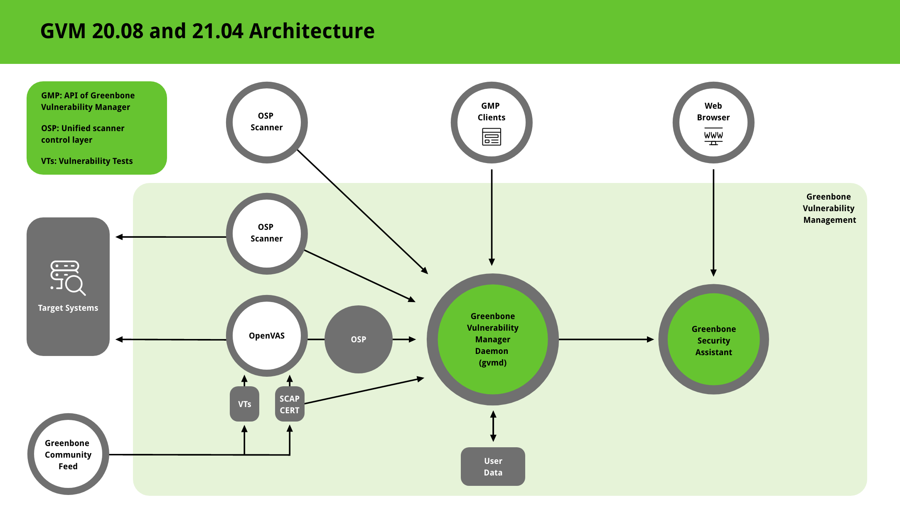
Topology Overview

Slide 5
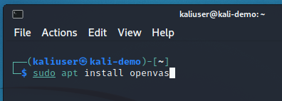
OpenVAS Install

Slide 6
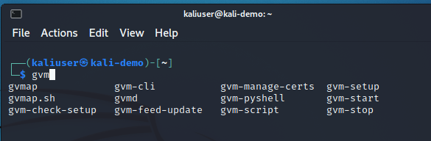
OpenVAS Install (Cont.)

Slide 7
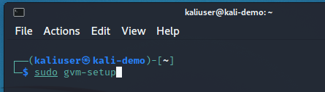
OpenVAS Install (Cont.)
Documentation Uses “Openvas”

Slide 8
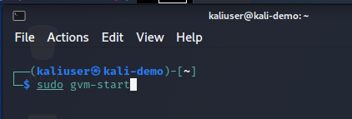
OpenVAS Install (Cont.)

Slide 9
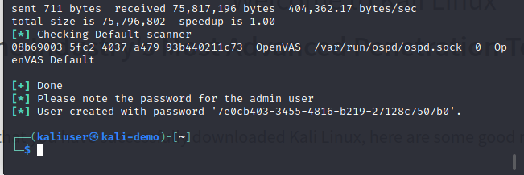
OpenVAS Install (Cont.)
Copy this for later use.

Slide 10
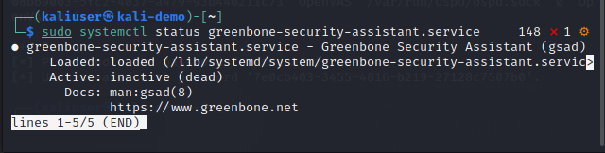
OpenVAS Install (Cont.)
Check these services

Slide 11
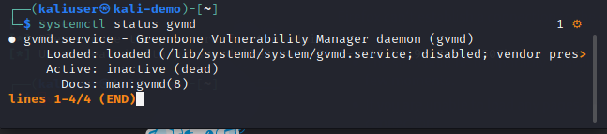
OpenVAS Install (Cont.)

Slide 12
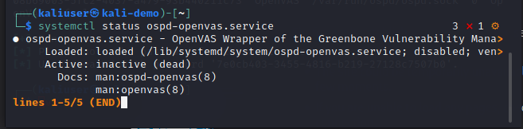
OpenVAS Install (Cont.)

Slide 13
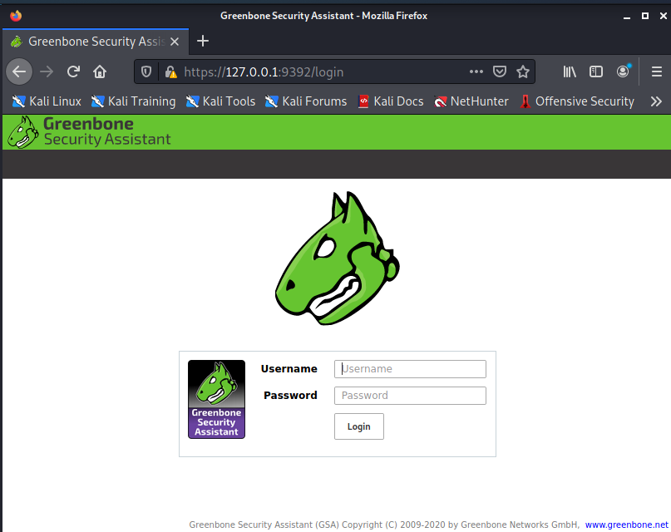

Slide 14
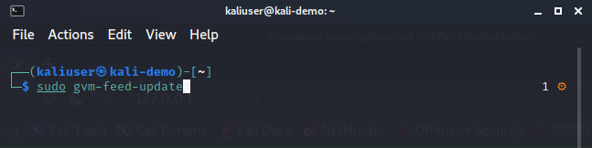
Update gvm feed

Slide 15
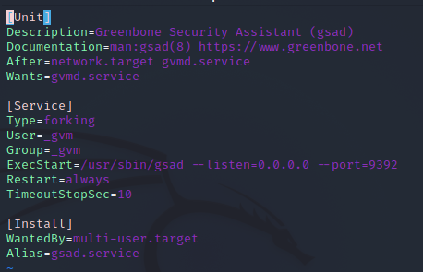
Set Web to listen on all ports
cd /lib/systemd/system
vi greenbone-security-assistant.service
Change 127.0.0.1 to 0.0.0.0

Slide 16
References
1. Online Admin Manual - https://docs.greenbone.net/GSM-Manual/gos-6/en/introduction.html
2. Kali Documentation - https://tools.kali.org/vulnerability-analysis/openvas
3. Kali Blog - https://www.kali.org/blog/configuring-and-tuning-openvas-in-kali-linux/

